Slide 1
InkSight: Leveraging Sketch Interaction for Documenting Chart Findings in Computational Notebooks
Yanna Lin
Haotian Li
Leni Yang
Aoyu Wu
Huamin Qu
1

Slide 2
Background
Computational notebooks are powerful tools to support data exploration and explanation in a single document which combine code, visualization, and text.
2
Rule elt. al, CHI 2018
Notes:
Computational notebooks are powerful tools for data analysis, blending code, visualizations, and text in a single document.

Slide 3
Background
Well-documented computational notebooks enhance recall, sharing, collaboration, and reproducibility in data analysis.
3
Rule elt. al, CHI 2018
Notes:
Well-documented notebooks are essential for effective data recall, sharing, collaboration, and reproducibility

Slide 4
Background
Documenting chart findings is tedious and time-consuming.
4
Notes:
But here's the thing: Documenting chart findings is often a cumbersome, time-consuming process.
Many scientists refuse to document findings especially when the content is very very long.

Slide 5
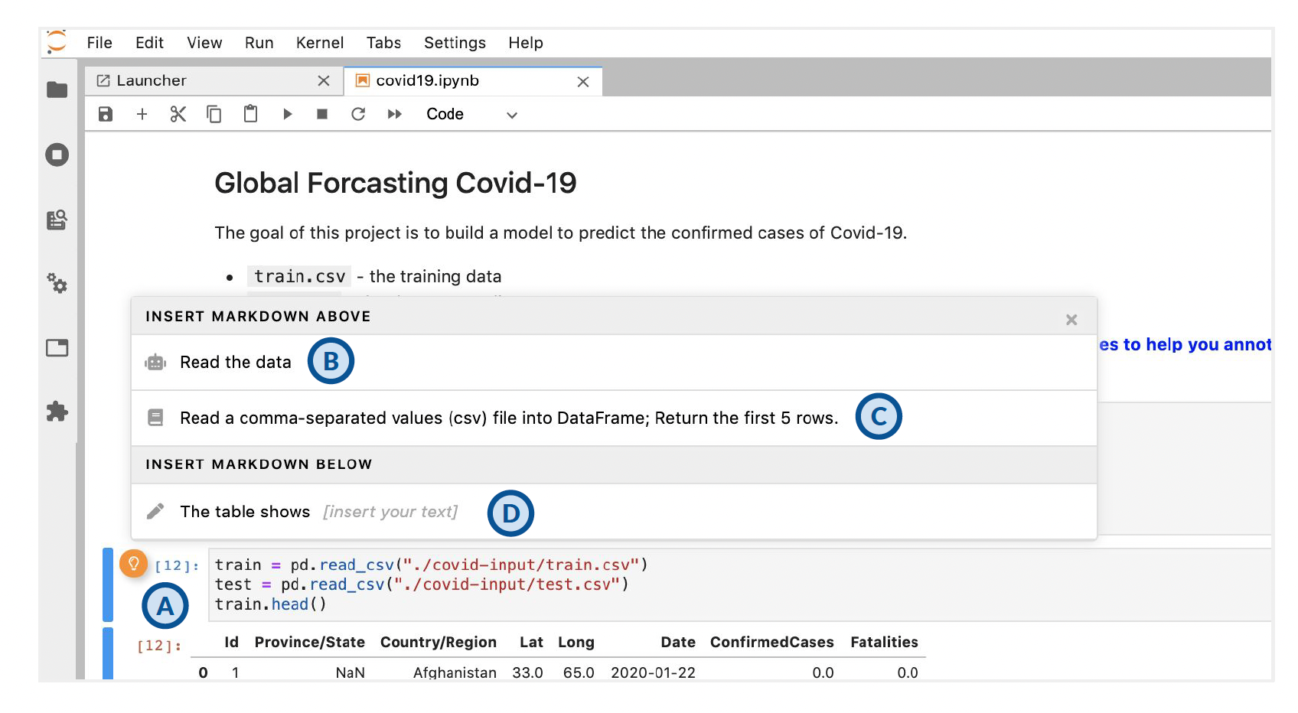
Related Work
Themisto provides a sentence starter to encourage users to document findings, leaving users to complete it manually.
Yi Wang et. al, Themisto, CHI 2022
5
Notes:
Current solutions try to ease this burden but fall short.
Themisto gives users a sentence starter but leaves users to complete it manually, making it a tedious task.

Slide 6
Related Work
Automatic algorithms for generating documentation fail to allow users to specify interest in specific data subsets.
Finding 1: 2009 is a turning point of Mean of Sales over the Year.
Mean of Sale
Finding 2: The Mean of Sales decreased from 2007 to 2009 and increased from 2009 to 2011.
Year
Haotian Li et. al, Notable, CHI 2022
6
Notes:
Automatic algorithms for generating documentation research often selects the most insightful and salient findings. but it may fail to meet user intent.
For example, for this visiualiztaions, it may have different findings, the first is about 2009 is a turning points the second is about the trend.
The algorithm may chose the first one while user may want to convey the second one.
Thus, the automated algorithm may not align well with user intents.

Slide 7
Contribution
A plugin, InkSight, allowing users to specify their intent by sketching for documenting chart findings with LLM in computational notebooks
7
Notes:
To fill this gap, we proposed InkSight, a computational notebook plugin. It allows you to users the intent via sketch and auto-generate corresponding chart finding documentation with Large Language Models.
这一页吧logo去掉

Slide 8
Demo
8
Notes:
Before going to the details, we can see a simple demo to see how it works.
With the plotted visualization, users sketch on the visualization to generate corresponding insights,
Then user can further refine the insights, such as clicking the content to edit the insights, group insights, order insights, or delete insights.
Now let’s delve into to see how it works.

Slide 9
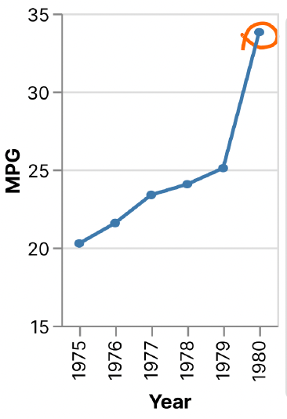
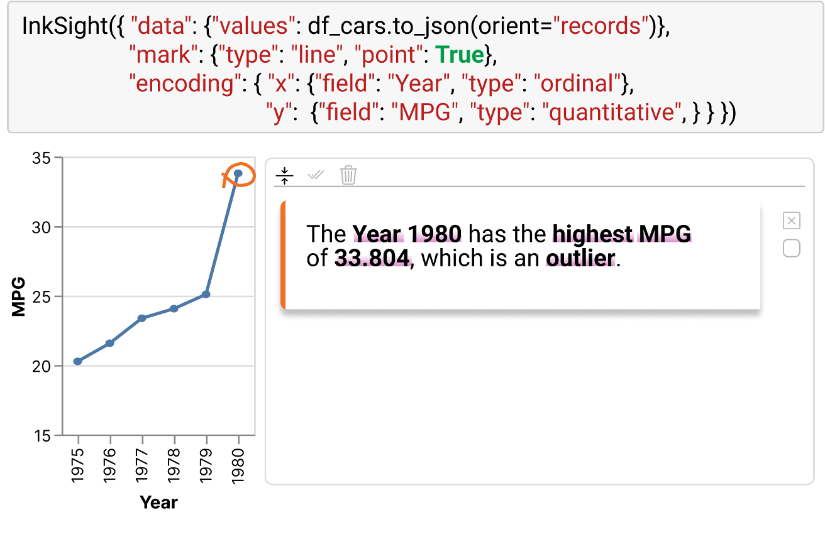
Workflow
User Input
Visualization & Sketch
Computation module
Generated documentation
9
Notes:
Here is the workflow of Inksight.
First, user plots the visualization and sketch the area of interest.
Then Inksight further identify the sketch, infer the user intent and generate the finding documentation correspondingly.
Finally, the generated documentation is shown in the jupyter notebook interface for further refinement.
Let‘s start with user input.

Slide 10
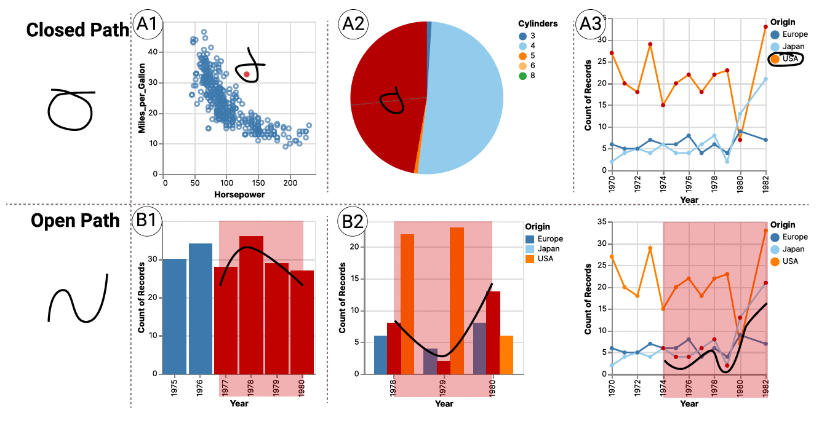
Workflow – User Input
Sketch Space
The selected data of interest is highlighted in red.
10
Notes:
Speicially, we provide a sketch space including open-path and close-path sketch
For the closed-path sketch, user can encircle those data points of interest by sketch.
We also enable user to select a group of interested data items through legends, since they may be difficult to single out by a closed path.
While the open path enable users to draw the trend that align with their mindset when they find they are interested for the trend.
Similar to the closed path, the tool offers a convenient way to select a group of data from the same category in multiple line charts and grouped bar charts.
we enable users to draw a sketch resembling the path of a specific group of data items they find interesting
For example, for the sketch in the middle one, the open path is more closed to the second group. thus the second group is highlighted as selected.

Slide 11
Workflow – Sketch Identification
Sketch Type: Closed path
Data Items of Interest: (Year=1989, MPG=33.8)
User Input
Visualization & Sketch
11
Notes:
After sketching, InkSight identifies the sketch by classifying its sketch type and pinpointing the selected data items.
This sketch type is closed-path sketch and the corresponding data item of interest is the point (year=1980, MPG=33.8).

Slide 12
Workflow – Intent Inference
Sketch Type: Closed path
Data Items of Interest: (Year=1989, MPG=33.8)
+
Data Type: Year x MPG (Temporal * Numerical)
#Data Items of Interest: 1
Data Fact Algorithm
R. Ding et. al, QuickInsights, SIGMOD2019
Data Fact Type: Outlier, Rank
User Input
Visualization & Sketch
12
Notes:
Based on this information, data types and number of data points of interest, InkSight then uses existing data fact algorithms to infer relevant data facts, i.e., rank and outlier for this sketch.

Slide 13
Workflow – Intent Inference
13

Slide 14
Workflow – Finding Documentation Generation
Data Fact Type: Outlier, Rank
Template
The (Year=1980, MPG=33.8) is an outlier in MPG.
The (Year=1980, MPG=33.8) ranks 1st in MPG.
accurate, concise, human-like
The Year 1980 has the highest MPG of 33.8, which is an outlier.
User Input
Visualization & Sketch
14
Notes:
Then, for each data fact, InkSight generates a description based on predefined templates.
Here, for the data fact outlier, the description is: The point is an outlier in MPG. While the description for data fact rank is: The point ranks 1st in MPG. Further, the LLM model is used to combine multiple data facts to be more accurate, concise, and human-like.
As a result, the final findings for this sketch is "The Year 1980 has the highest MPG of 33.804, which is an outlier."

Slide 15
Workflow
User Input
Visualization & Sketch
Computation module
Generated documentation
15
Notes:
So, this is the complete workflow, from user input to the final generated documentation.

Slide 16
Workflow – Refinement
Add
Edit
Group
Delete
Add
Order
16
Notes:
But we didn't stop here. InkSight also offers interactive features for refining these auto-generated findings. Users can add, edit, group, delete, and reorder the generated findings.

Slide 17
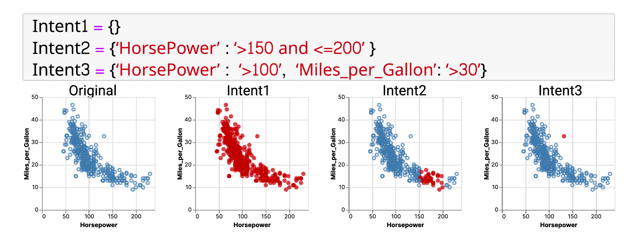
User Study
12 participants
Baseline
Intent expression: Code-based method to express user intent
Documentation generation: Same as InkSight
17
Notes:
Our user study, involving 12 participants, compares inkSight with a Baseline, which enables users to express user intent by programming since it is a common approach to identify data of interest.
Despite the difference in how users express their intent, other aspects of inksight and baseline remain consistent.

Slide 18
User Study – Quantitative Result
InkSight consistently achieved higher average ratings than baseline in both usability and effectiveness.
18
Notes:
The user ratings confirmed that InkSight outperformed baseline in both usability and effectiveness.

Slide 19
User Study – Qualitative Result
InkSight streamlines the documentation process and provides additional benefits, including enhancing data analysis and fostering effective collaboration.
“InkSight with sketch aligns well with my analysis habits. When I record findings, I observe the points and trends and take notes on the charts directly.”
19
Notes:
For the qualitative results, participants thought that InkSight streamlines the documentation process and provides additional benefits.
For example,one participant mentioned that Sketch aligns well with his analysis habits, since he will observe the points and trends and take notes on the chart directly to record findings.

Slide 20
User Study – Qualitative Result
The quality of documentation generated by InkSight is thought highly by the participants.
“The generated ones is what I needed, and most of the time, I can share to others directly.”
20
Notes:
The participants also thought highly of the documentation, one Participant mentioned that the generated documentation can be shared directly to others.

Slide 21
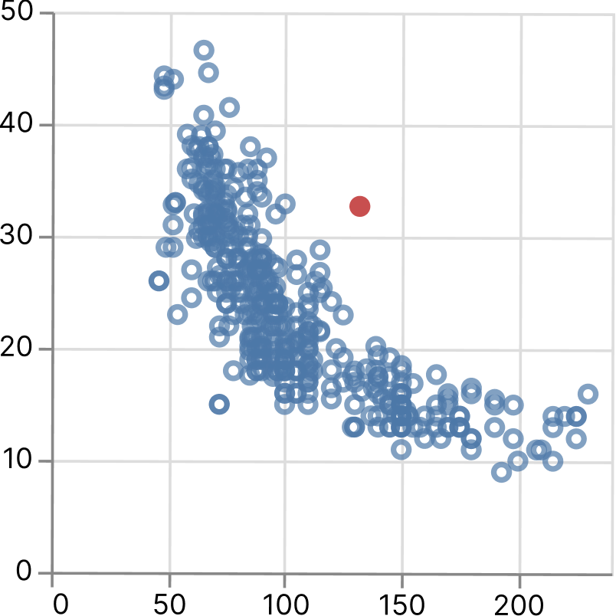
User Study – Qualitative Result
The sketch interaction in InkSight is considered a flexible and easy way to express intent by the majority of the participants.
Limitations of Baseline:
Excessive demands of details
Rigid input specification
Miles_per_Gallon
“When coding my intent, I just feel like I work as a compiler to translate my intent to a grammar, which is really unnatural and unfriendly.“
Horsepower
Intent = {"Horsepower": ">100", "Miles_per_Gallon": ">30"}
21
Notes:
Moreober, most of participants recognized that sketch is considered a flexible and easy way to express intent
For example, they can select this point of interest by sketch easily.
While for the code-based interaction, to represent the same intent, users need to read this chart carefully to infer the precise location of the point, and program it very carefully to avoid any errors.
This process of tranlating intent to grammar is really demanding and participant though it unnatural and unfriendly.

Slide 22
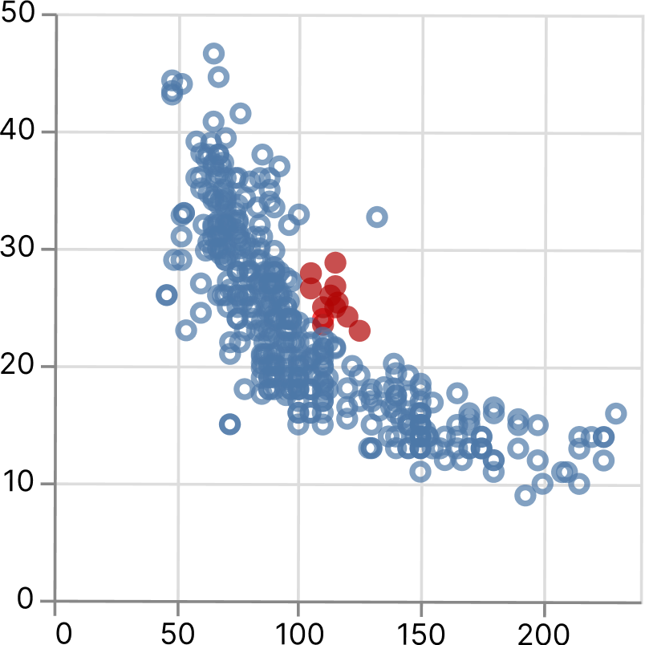
User Study – Qualitative Result
The sketch interaction in InkSight is considered a flexible and easy way to express intent by the majority of the participants.
“I can draw any shapes to see the results with a low burden“.
Miles_per_Gallon
Horsepower
Intent ={????}
22
Notes:
What`s more, inksight can support users to draw any shapes they want.
However, users find that some of the shapes is hard to describe in code.

Slide 23
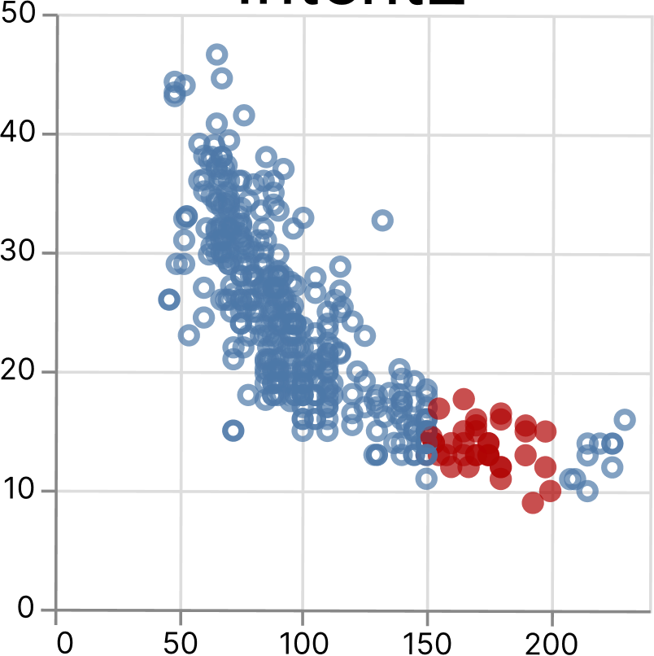
User Study – Qualitative Result
In some case, code-based interaction is more accurate in expressing user intent.
Limitations of InkSight:
Error-prone to select unwanted points
Miles_per_Gallon
Horsepower
Intent = {"Horsepower": ">150 and <200”}
23
Notes:
But sketch interaction is not always the better solution to express intent.
For example, if user are interested in the area with horsepower exactly during 150 and 200.
It is error-prone for users to use sketch to select this area since the area of interested is surroneded by many unwanted ones.

Slide 24
Limitations & Future Work
Enabling user to express intents through multi-modal interaction methods
Interaction method | Pros | Cons
Sketch | Intuitive, natural, easy, flexible, effortless | Error-prone to selected unwanted ones
Code-based | Precise | Excessive demands of details, rigid input specification
24
Notes:
As we have concluded from the qualitative results of the user study, both sketch and code-based methods have its advantages and disadvantages,
one potential direction for future work is to support multi-modal interactions (e.g., [45]) simultaneously, maximizing the benefits of each method while minimizing their respective drawbacks.

Slide 25
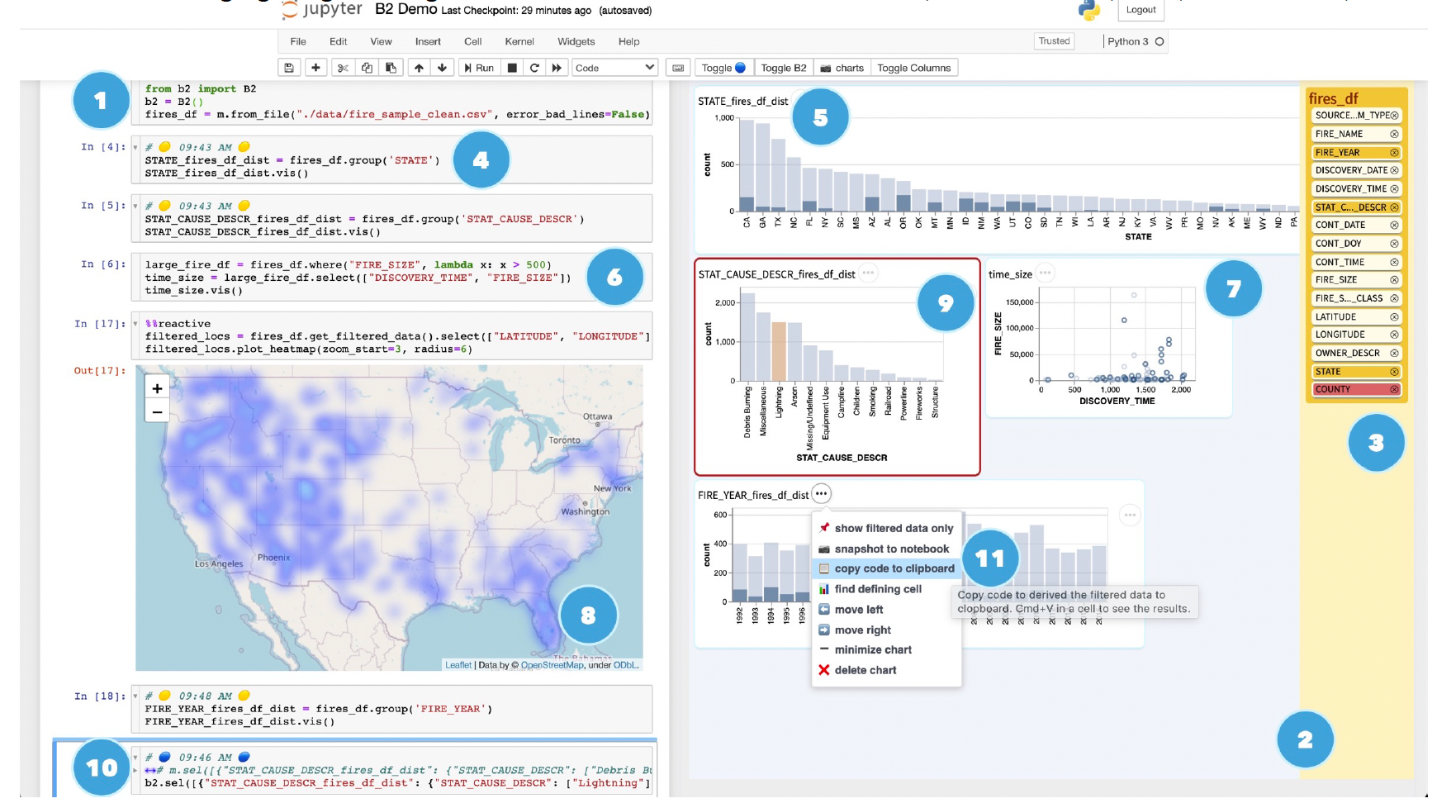
Limitations & Future Work
Enhancing the quality of documentation
Support documentation that spans multiple code cells and corresponding charts
Yifan Wu elt. al, BI2, UIST 20
25
Notes:
Moreober, inkSight now just focus on a single visualization.
While many research have confirm that the visualizations in jupyter notebook is interconnected.
Since analysts frequently base subsequent explorations on previous findings.
In the future, it will be interesting to enhance InkSight by supporting documentation that spans multiple code cells and corresponding charts

Slide 26
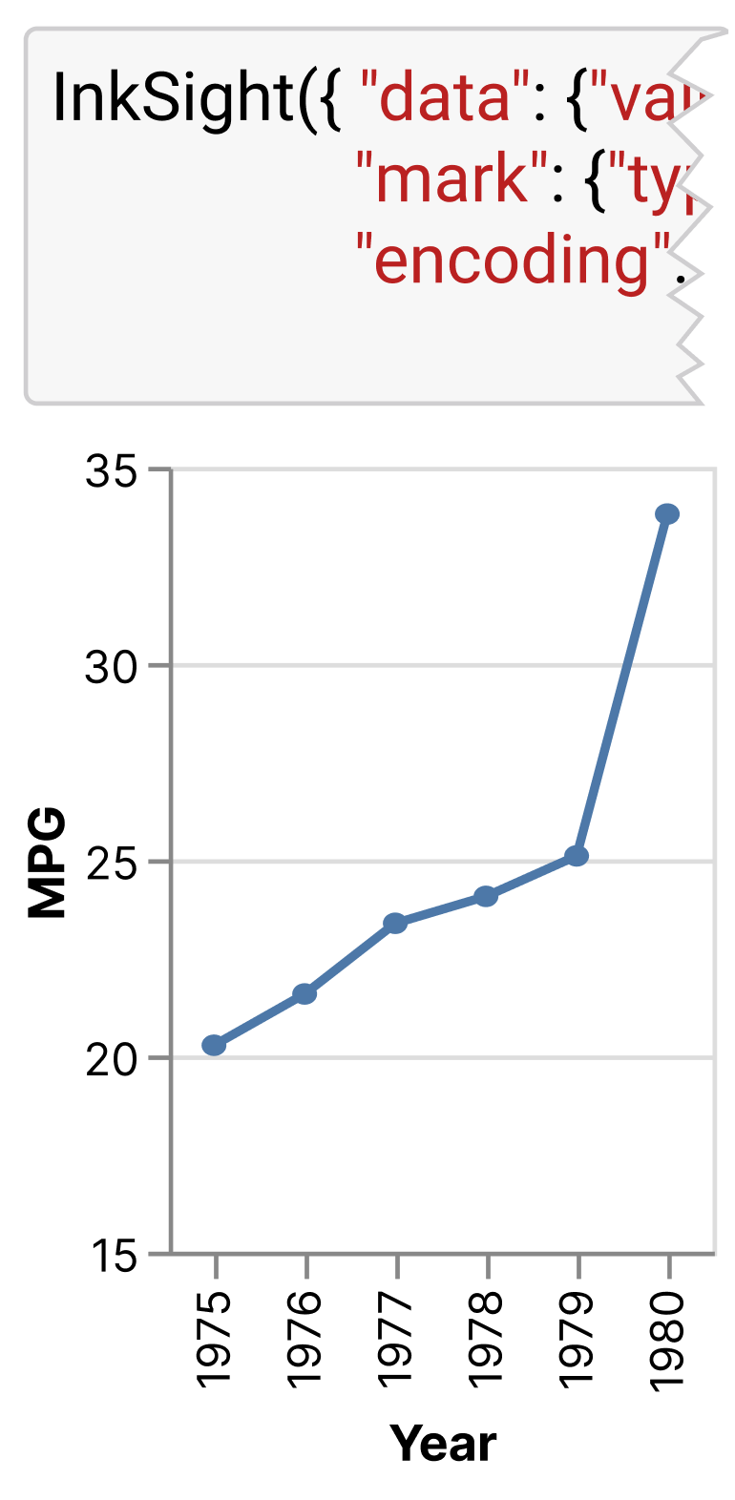
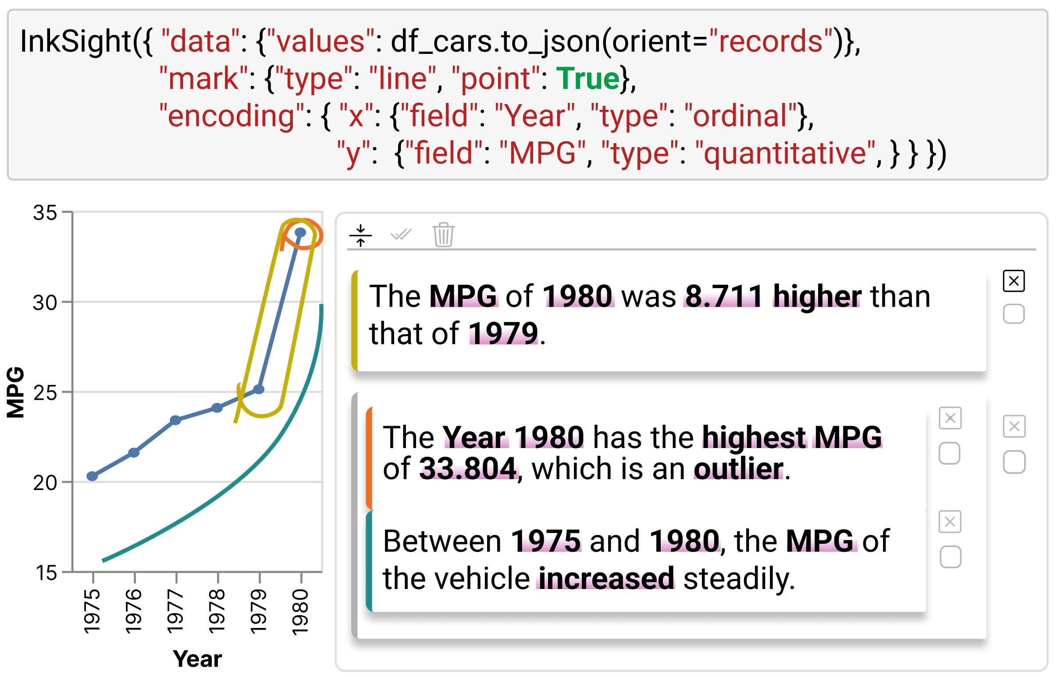
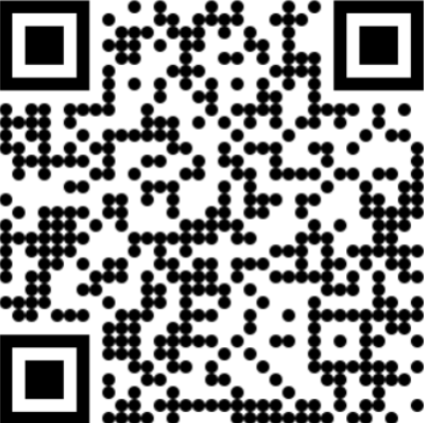
Leveraging Sketch Interaction for Documenting Chart Findings in Computational Notebooks
InkSight
Q & A
Yanna Lin
I‘m on the job market.
https://yannahhh.github.io
Thank you!
Notes:
To sum up, InkSight isn't just a plugin; it's a paradigm shift.
By enabling sketch-based intent expression, we step forward effective, efficient, and engaging chart finding documentation in computational notebooks.

