Slide 1
DMiner: Dashboard Design Mining and Recommendation
Yanna Lin¹
Haotian Li¹
Aoyu Wu¹
Yong Wang²
Huamin Qu¹
1
2
1

Slide 2
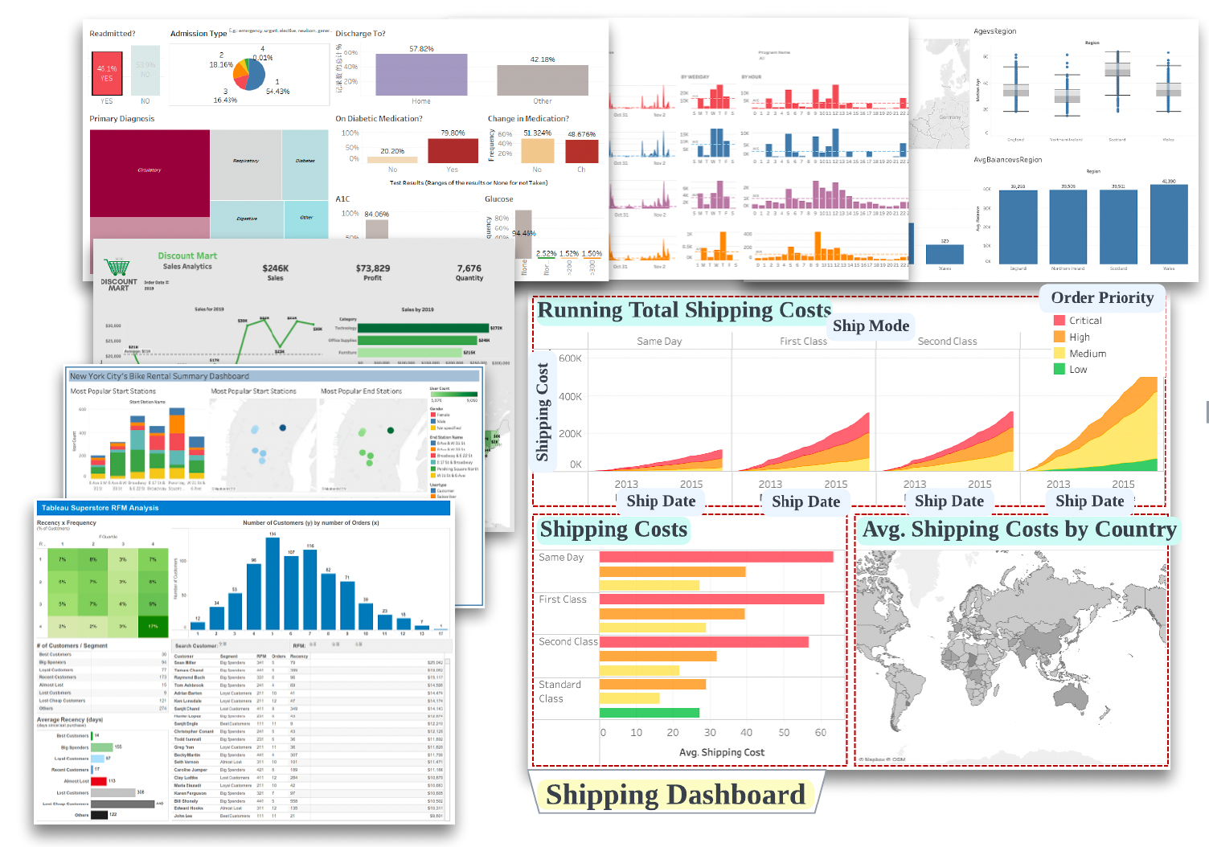
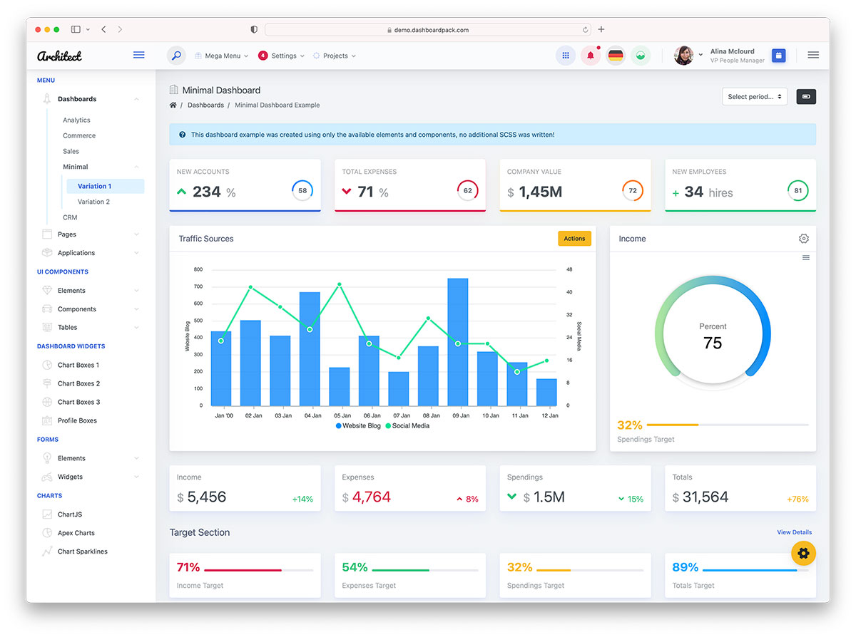
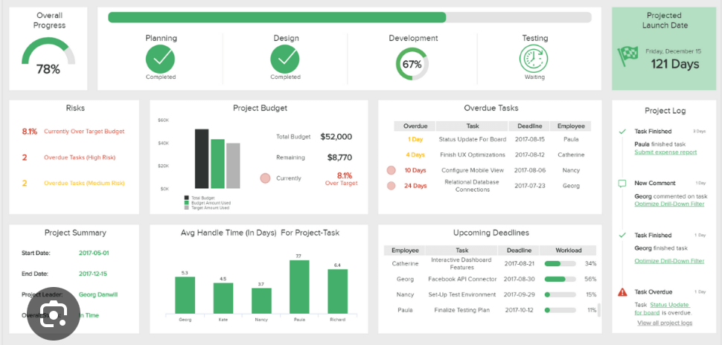
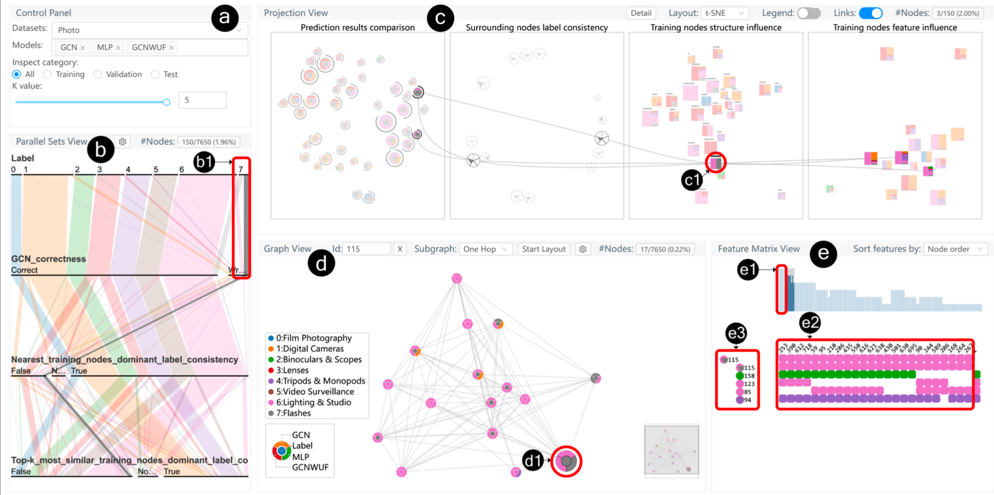
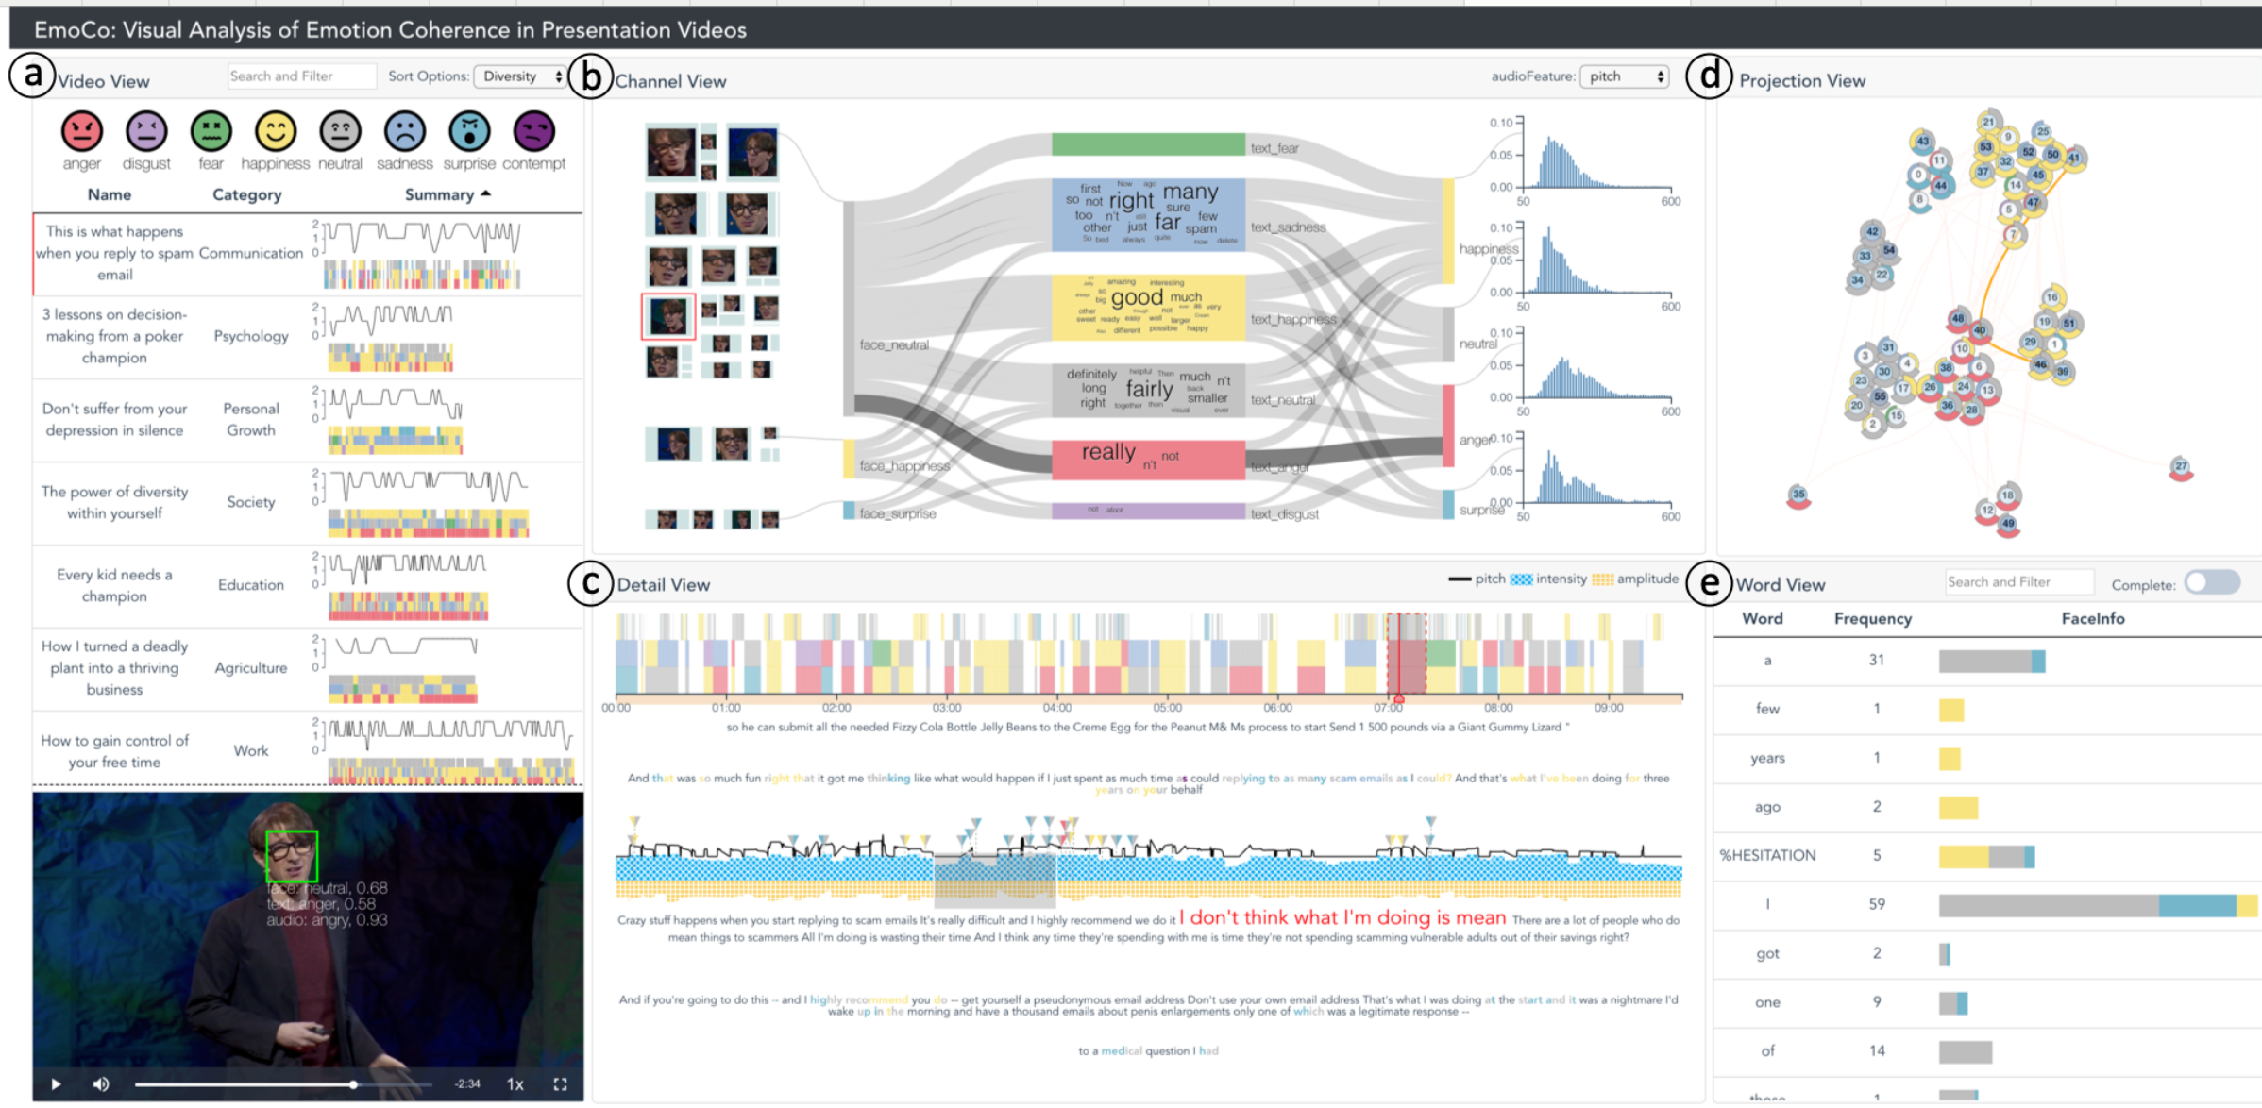
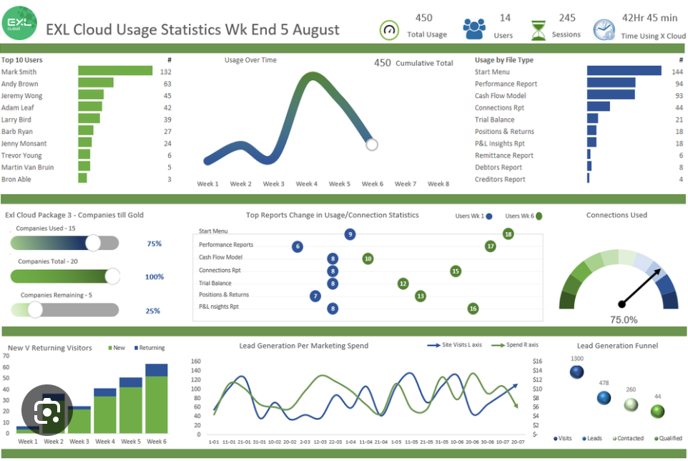
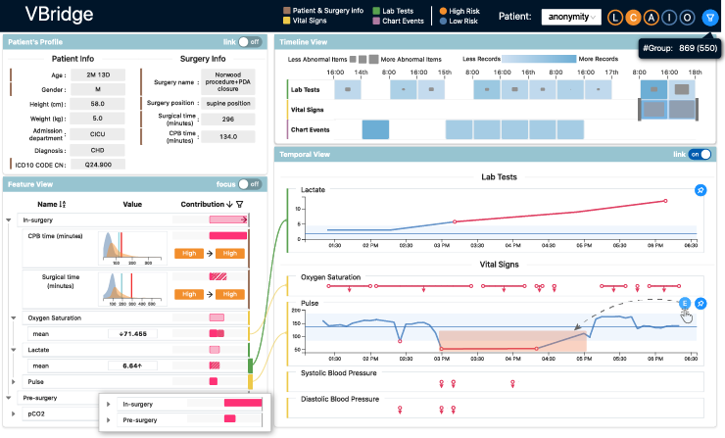
Background
Multi-view dashboards (MVs) are becoming increasingly popular in data analysis because of their ability to display data from different perspectives simultaneously.
2
Notes:
Multi-view dashboards have gained increasingly popularity in data analysis for their ability to present multiple perspectives of data at the same time.

Slide 3
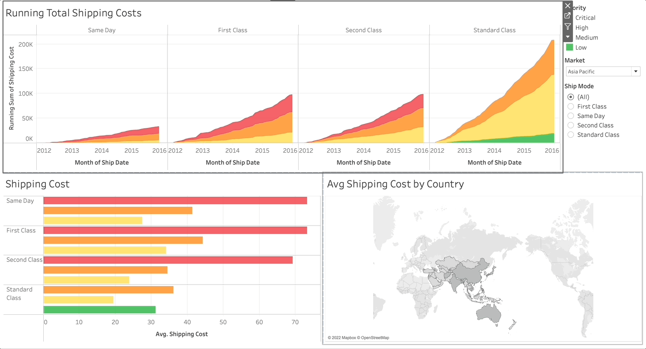
Background
Pipeline of creating MV
View Creation
View Arrangement (Position + Size)
View Coordination (Interaction)
3
Notes:
Creating a dashboard typically starts with creating views of interest, followed by arranging and coordinating the selected views.
Specifically, this paper focus on the dashboard arrangement and coordination.

Slide 4
Background
Creating proper arrangement and coordination for MVs is tedious and time-consuming since the candidate space is large.
View Order
View 3
View 2
View 1
View 2
View 3
View 1
…
View3
View2
View1
View Size
…
Layout candidates
Variants
5
Notes:
However, Creating proper arrangement and coordination for MVs is really challenging since the candidate space is large.
For example, given three views, there are four potential layout candidates.
Each of these candidates introduces further variations, influenced by factors like view order and view size.
This situation will become more complicated when there are more views.

Slide 5
Related Work
High-level design guidelines are too abstract to provide actional suggestions.
Rule of Attention Management: Use perceptual techniques to focus the user’s attention on the right view at the right time.
Rule of Self-Evidence: Use perceptual cues to make relationships among multiple views more apparent to the user.
Michelle Q., et al. (AVI 2000)
6
Notes:
To solve this problem, some research propose design guidelines, but these are often too abstract to provide actionable suggestions,
such as, drawing users’ attention to the right view and making cross-view data relationships more obvious.

Slide 6
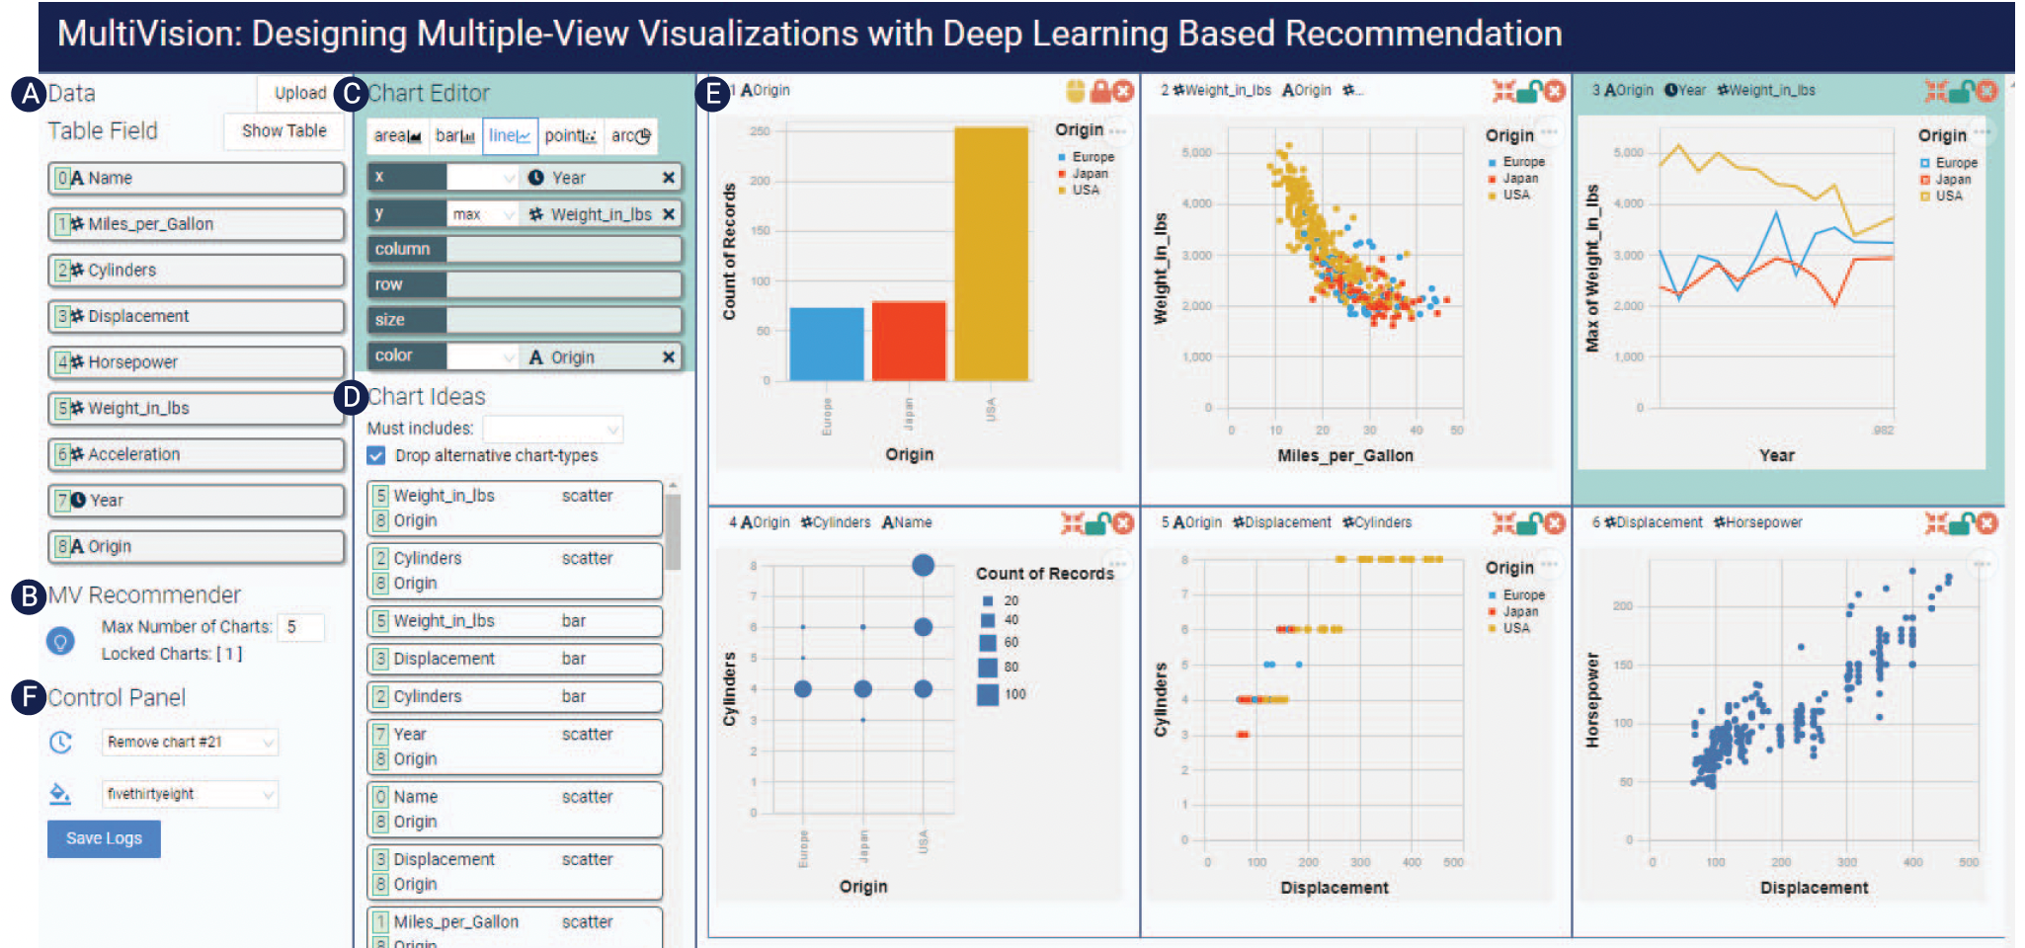
Related Work
Tools are developed to facilitate creating MVs, but they do not focus on the arrangement and coordination among views.
Wu, Aoyu, et al. (TVCG 2021)
7
Notes:
Moreover many tools, such as MultiVision, are developed to help create MVs.
However, they mainly focused on view creation while just offer default layout templates, which may require extensive manual adjustment to meet specific needs.
Thus, until now, still no tools focus on arrangment and coordination of MVs.

Slide 7
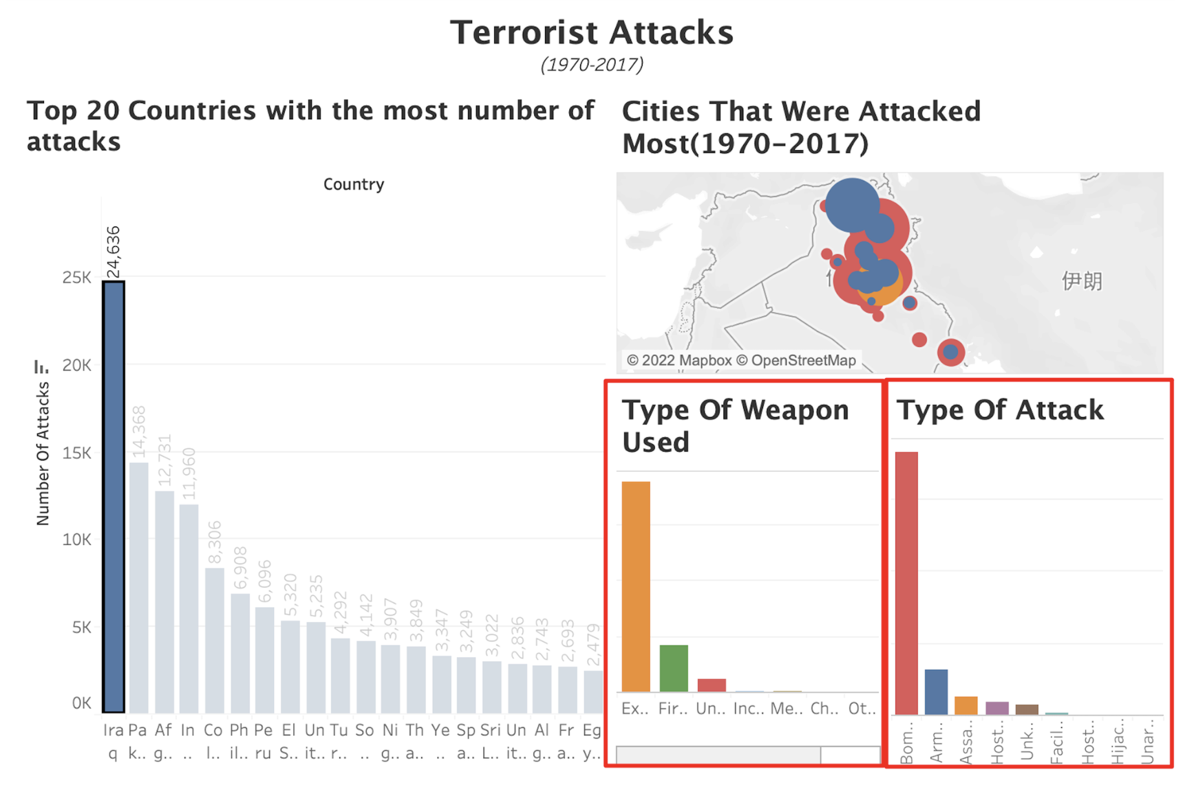
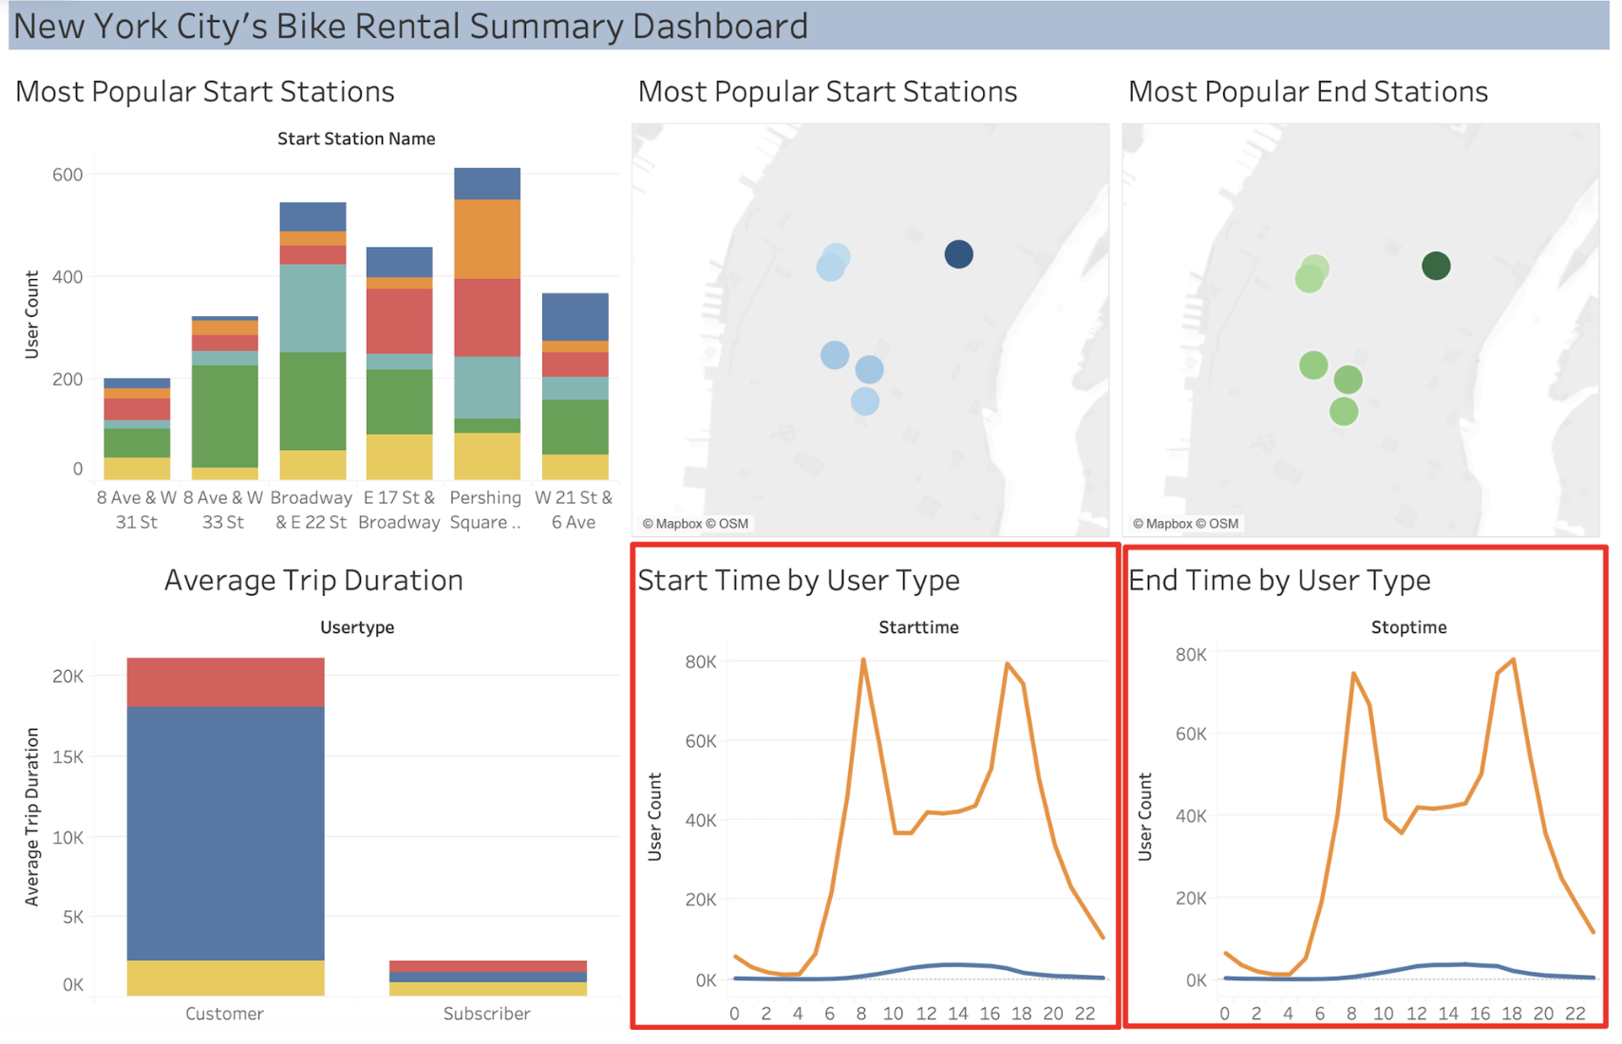
Background
Core idea: Mine common design practices from existing dashboards
The first view is an overview that guides analysis and exploration.
Views with same chart type are arranged side by side.
8
Notes:
To solve this problem, the core idea of this work is to mine common design practices from existing dashboards.
Since we found that dashboards shared some common design practices.
For example, for these two dashboard, they all have the following two patterns:
The first view is an overview that guides analysis and exploration.
And, views with same chart type are arranged side by side to compare.

Slide 8
Contribution
DMiner, a data-driven framework, for mining dashboard design and automating the layout arrangement and view coordination for MV dashboards
9
Notes:
To achieve this idea, we propose DMiner, a data-driven framework.
Specifically, Dminer consists of three components, i.e., feature engineering, design rule mining and recommender.
With the collected dashboard dataset, Dminer first extracts single-view and pairwise-view features.
Subsequently, based on these extracted features, DMiner delves into mining design rules.
Then, armed with these design rules, DMiner establishes a recommender to help recommend arrangement and coordination for a given set of visualizations.
I will introduce them in detail next.
So, Let’s start with the dataset collection.

Slide 9
Dataset Collection
Collect dashboards from Github
Dashboard
Raw workbook
10
Notes:
First, we collected dashboards from Github. Each dashboard has the corresponding workbook, which is in XML format and contains rich information to render the dashboards, such as the visual encodings and coordination among views.

Slide 10
Framework
11
Notes:
Then, we proceeded with feature engineering to distill key features from the dataset.

Slide 11
Framework – Feature Engineering
Extract information from the raw workbook of dashboard
Raw workbook
Information
12
Notes:
First, DMiner extract the rich information from the workbooks, such as mark type, encodings, positions and so on.

Slide 12
Framework – Feature Engineering
Extract single-view and pairwise-view features based on the information
#Used data columns
Mark type (Area)
Position (x, y, w, h)
Single-view features
Derive
Derive
IsNeighbor
Direction
Pairwise-view features
Same mark type
Subset
Brush
Filter
13
Notes:
Based on the rich information, Dminer further proceed to extract two primary categories of features: single-view and pairwise-view features.
The single-view features includes the data and encoding features, which describe the utilized data columns of the view and their correspondence to different visualization channels, such as the number of used data columns and the mark type.
And also the arrangement features, which detail the position of the view within the dashboard.
For the pairwise-view features, they are derived from the single-view features to describe the relationship of view pairs.
Specifically, Data and encoding relationship features describes whether two views share the same mark types or if the data columns in one view are a subset of another.
the arrangement relationship determines if one view is neighborhood to the other.
Furthermore, coordination feature describes the type of interaction the two views share.

Slide 13
Framework
14
Notes:
Moving on, with these extracted features in hand, DMiner then proceeds to mine design rules.

Slide 14
Framework – Design Rule Mining
Prior theories suggests that
Data and encoding → dashboard arrangement and coordination
Arrangement ← → coordination
15
Notes:
Prior theoretical work has shown that features related to data and encoding are critical to dashboard arrangement and coordination.
Furthermore, arrangement and coordination are inherently interconnected.
Thus, we build the mapping relationship between these features.

Slide 15
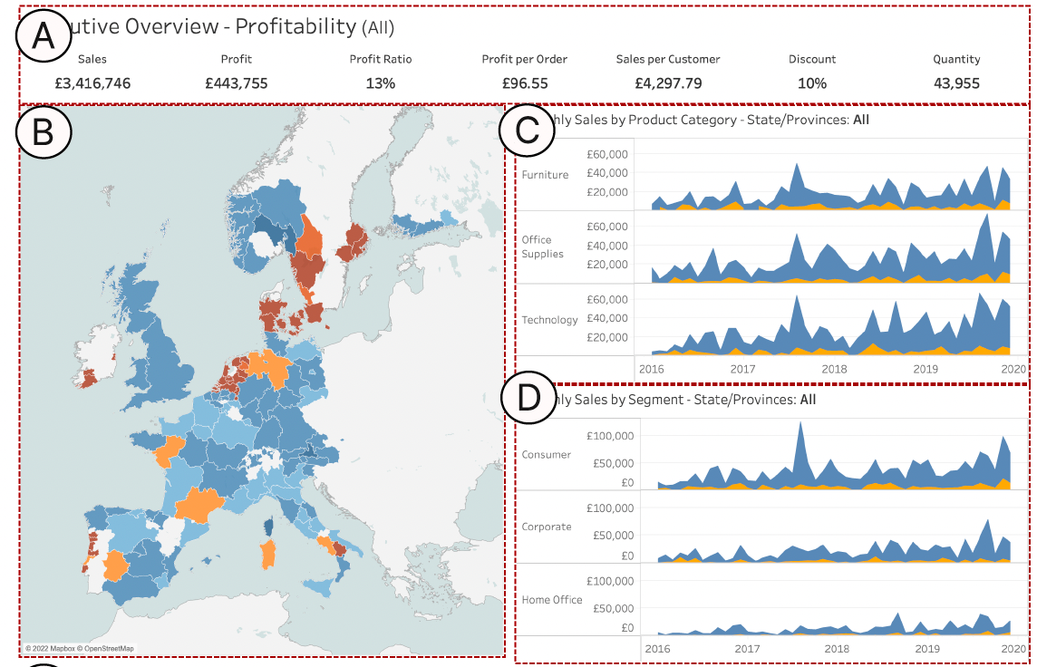
Framework – Design Rule Mining
DMiner adopts the associated rule mining algorithm to get design rules.
Expert:
Overview first,
details on demand
16
Notes:
We then adopt the associated rule mining algorithm to get design rules.
This is one example rule, which suggests that "If View B utilizes fewer data columns than View D, then View D should be positioned on the bottom right of View B."
During our expert study, experts explained that View B with fewer data columns is a simpler view, which is more likely to be an overview, thus should be on the left of view D.
Thus, they think this rule logical, aligning with the design guidelines of 'overview first, details on demand'."

Slide 16
Framework
17
Notes:
Then, we proceeded to the recommmendet

Slide 17
Framework – Recommender
Given multiple views, DMiner explores all potential arrangements and coordinations as candidates.
The candidate that meets most design rules is the recommended arrangement and coordination.
18
Notes:
Given multiple visualizations, DMiner explores all potential arrangements and coordination as candidates.
The final recommendation is the candidate that aligns with most mined design rules.

Slide 18
Framework
19
Notes:
In summary, DMiner presents a comprehensive framework that spans from initial data collection to final dashboard design recommendation.

Slide 19
Evaluation
User Study
Expert Study
20
Notes:
We conducted a user study and an expert study to evaluate the effectiveness of DMiner.

Slide 20
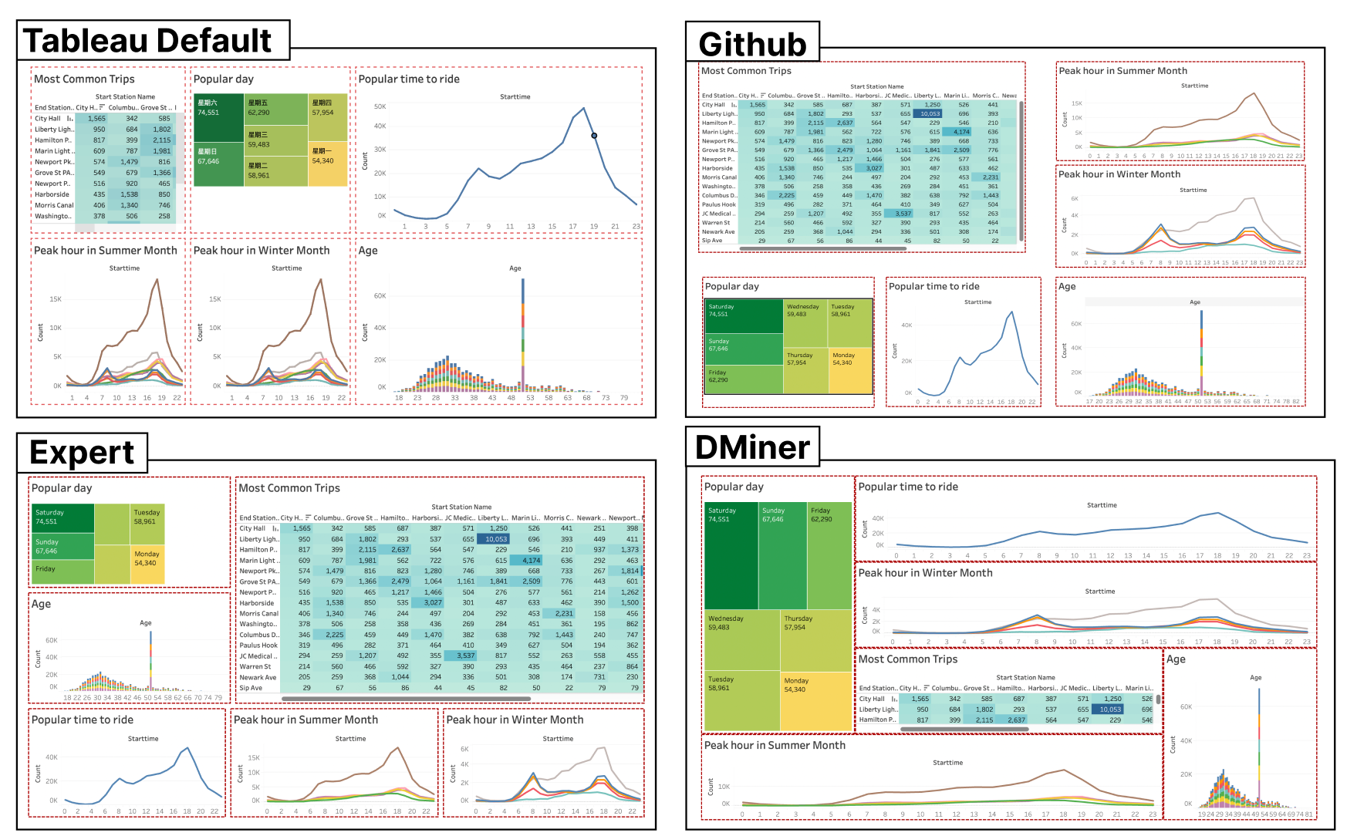
Evaluation – User Study on MV Recommendation
12 participants
Comparison study
Tableau Default
Github
Expert
DMiner
21
Notes:
Starting with the user study, we recruited 12 participants to conduct a comparison study of these 4 variants.
As shown in the right, Participants were given the MV recommendation from different methods.

Slide 21
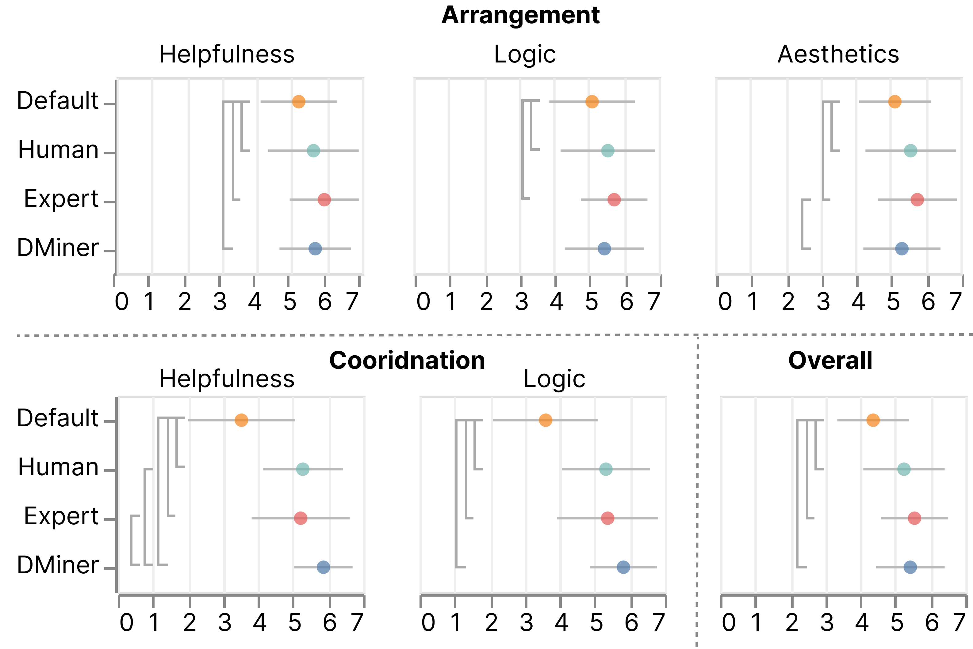
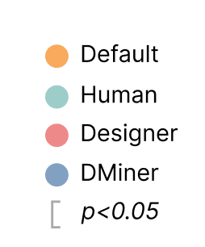
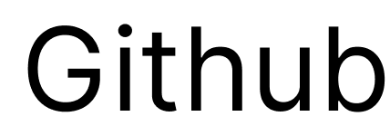
Evaluation – User Study on MV Recommendation
DMiner could simplify dashboard arrangement and coordination and reach human-level performance.
22
Notes:
then participants were asked to rate these MV recommendations in terms of the arrangement, coordination, and overall
For all perspectives, DMiner has significant better results than Tableau default in all perspectives, while similar score with recommendation from Github and Experts.
Which means that DMiner not only simplifies the dashboard arrangement and coordination process but also reaches human-level performance.

Slide 22
Evaluation – Expert Study on Design Rules
4 experienced dashboard design experts
Score the appropriateness of design rules and give justification
Results:
4.44 ± 1.32 (7-point)
Reasonable and align well with experts’ design knowledge
24
Notes:
While for the expert study, we recruited 4 experienced dashboard design experts to score the appropriateness of the extracted design rules and give the justification.
The average score came in at 4.44
And for most rules, experts thought they are reasonable and align well with experts' design knowlegde.

Slide 23
Evaluation – Expert Study on Design Rules
Design guidelines: Configure the two views used for comparison in a similar and close manner.
25
Notes:
For example, this is one design rules that is highly recognised by experts with an average score of 6.5.
Which describes that, if view A has same mark type and same Y-axis with view B, then view A should be on the left or right of view B.
Its correponding high-level design guideline is that : Configure the two views used for comparison in a similar and close manner.

Slide 24
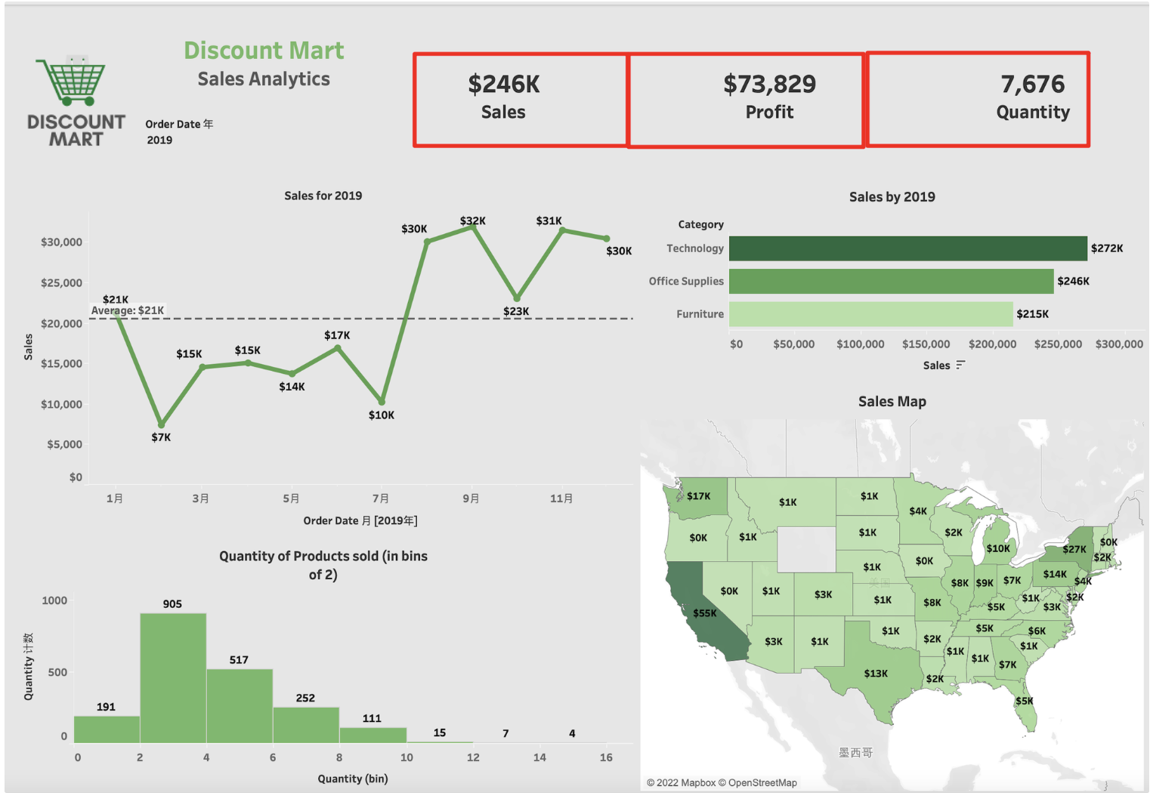
Lessons & Future Work
Dataset quality
More high-quality and informative dashboard datasets
Metrics to measures the dataset quality
Rule: Text view should be on the top of the dashboard.
26
Notes:
While our findings have yielded some interesting and actionable design rules,
there are still some limitations of our tools.
First, our rules are highly dependent on the dataset quality.
One of the rule is that Text view should be on the top of the dashboard. This is beacause most Text views in our collected dataset are statistics, serving as an overview.
But it may not always the case.
Thus, we encourage the whole visualization community to contribute More high quality and informative dashboard datasets and also metrics to measures the dataset quality

Slide 25
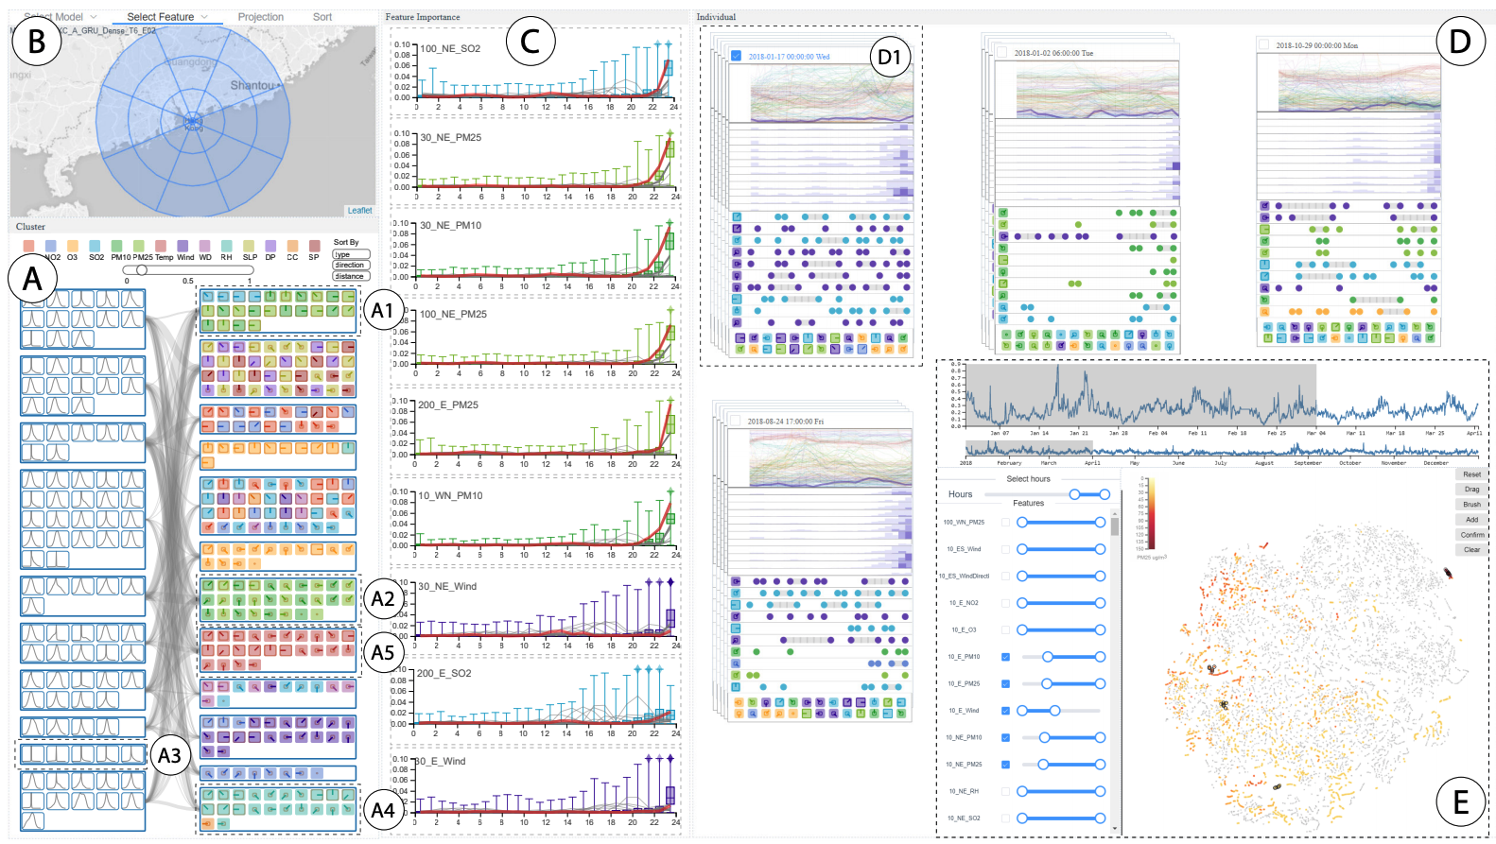
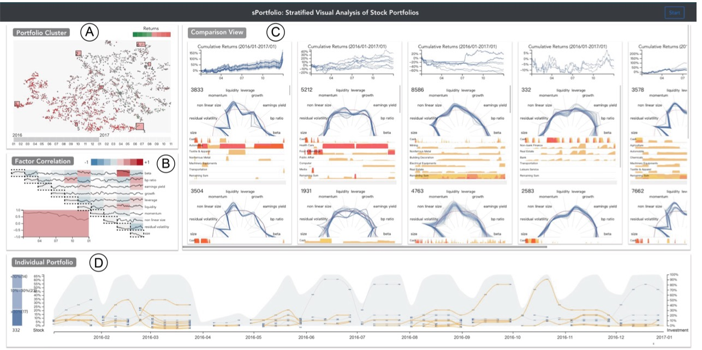
Lessons & Future Work
Trade-offs between common patterns and personal experience
Rule: Scatterplot should be on the right-most (3.5 ± 3)
Expert1: used scatterplots to show specific details ➔ right (rating: 6)
Expert2: used scatterplots to show T-SNE results as an overview ➔ left or top (rating:2)
Qiaomu Shen et. al, PacificVis 2020
Xuanwu Yue et. al, sPortfolio, TVCG 2019
27
Notes:
Secondly, experts' personal experiences significantly influenced the evaluation scores
For example, the rule "Scatterplot should be on the right-most" received an average score of 3.5 with a high variance of 3.
Expert1 uses scatterplots to show specific details and agreed with the rule.
While Expert3, who uses scatterplots to show T-SNE resultsa as an overview, prefers them to be on the top or left,
So, in the future, we can explore the Trade-offs between common patterns and personal experience.

Slide 26
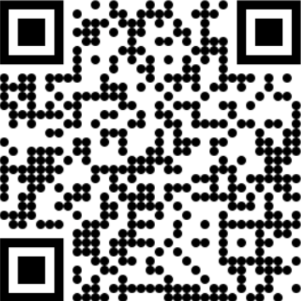
DMiner: Dashboard Design Mining and Recommendation
Q & A
Yanna Lin
I‘m on the job market.
https://yannahhh.github.io
Thank you!
29
Notes:
To sum up, we proposed DMiner, a data-driven framework, for mining dashboard design and automating the layout arrangement and view coordination for MV dashboards.

